Slide 1
Budgeting Platform
A Full-Stack Financial Ecosystem powered by Django

Slide 2
Developed by
NAMES
IDS
Emails
Amr Tamer Abdellatif
Andro Hazem Samir
Hazem Hosny Hamed
Manal Ezzat Ahmed
20240394
20240093
20240150
20242450
20240394@stud.fci-cu.edu.eg
20240093@stude.fci-cu.edu.eg
20240150@stud.fci-cu.edu.eg
20242450@stud.fci-cu.edu.eg

Slide 3
Ownership Report
Amr Tamer Abdellatif
Andro Hazem Samir
Hazem Hosny Hamed
Manal Ezzat Ahmed
savings goals & dashboard
budgets
users & transactions
user profile

Slide 4
Software Scope
The proposed system is a personal budgeting application that allows users to record their financial
transactions, including income and expenses. Users will be able to categorize their expenses (such as food, transportation, bills, and entertainment), create budgets for different categories, and
monitor their spending over time. The system will also provide features such as setting financial goals, tracking progress, and generating simple reports and visual insights (charts and summaries) to help users better understand their financial behavior.
The application is available as a web application to ensure accessibility and ease of use, especially for users in Egypt and the Arab region who may not currently use advanced financial management tools.

Slide 5
Technology Stack & Development Environment
Full-Stack Web Application: A complete end-to-end system with a dynamic user interface and a robust server-side architecture.
Back-end Development:
● Primary Language: Python
● Web Framework: Django
● Database: SQL
Front-end Development:
● Markup & Styling: HTML & CSS3.

Slide 6
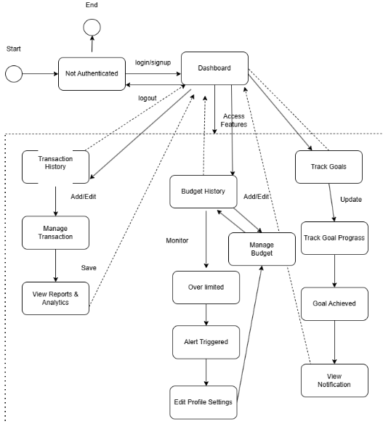
System User Flow
A detailed architectural flowchart illustrating the user's journey from authentication to core financial activities. It maps out how the Dashboard serves as the central hub connecting Transaction management, Budget monitoring (including over-limit alerts), and Goal tracking milestones.

Slide 7
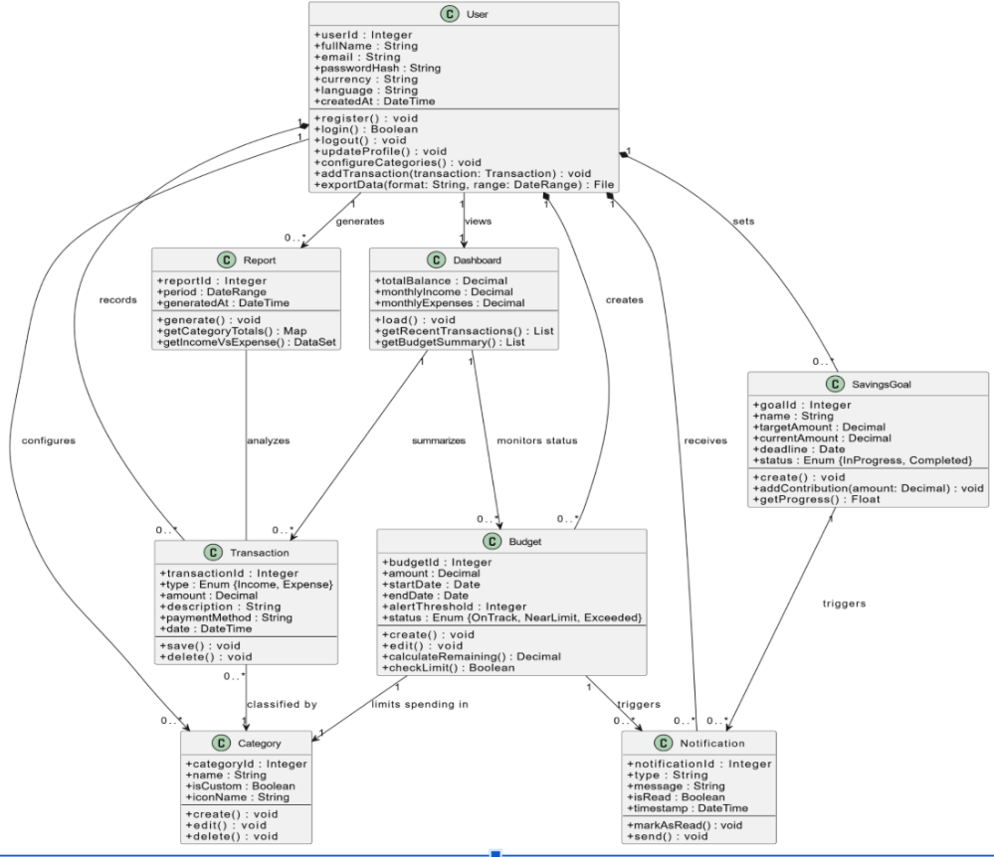
Class Diagram
This Class Diagram illustrates the object-oriented structure of our system. It centers around the User entity, which manages multiple associations: creating Transactions, setting Savings Goals, and monitoring Budgets. The diagram also highlights the automated Notification system triggered by budget limits and the Report generation logic for data analytics.

Slide 8
Core Features
User Component
  Allows new customers to register.
  Validates data when signing in.
  Stores users data in the database and redirects them to the dashboard page.
profile Component
  Displays users personal information.
  Allows editing users information.
  Allows users to change account settings and check notifications.
Budgets Component
  Displays budget usage for each category.
  Updates after adding expenses.
  Sends a notification if a budget is about to run out.
  Allows adding new budgets.

Slide 9
Core Features
Transactions Component
  Displays income and expense history.
  Allows users to filter based on category.
  Allows users to add new transactions.
  Allows linking a transaction of type income to a savings goal.
Notification
System alerts sent to the user regarding budget limits
Savings Goals Component
  Displays savings progress for each goal.
  Allows adding savings contribution manually.
  Allows adding new savings goals.
  Sends notification when a savings goal is reached
Dashboard
The main screen that shows a summary of the user’s financial data.

Slide 10
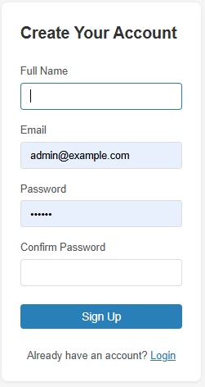
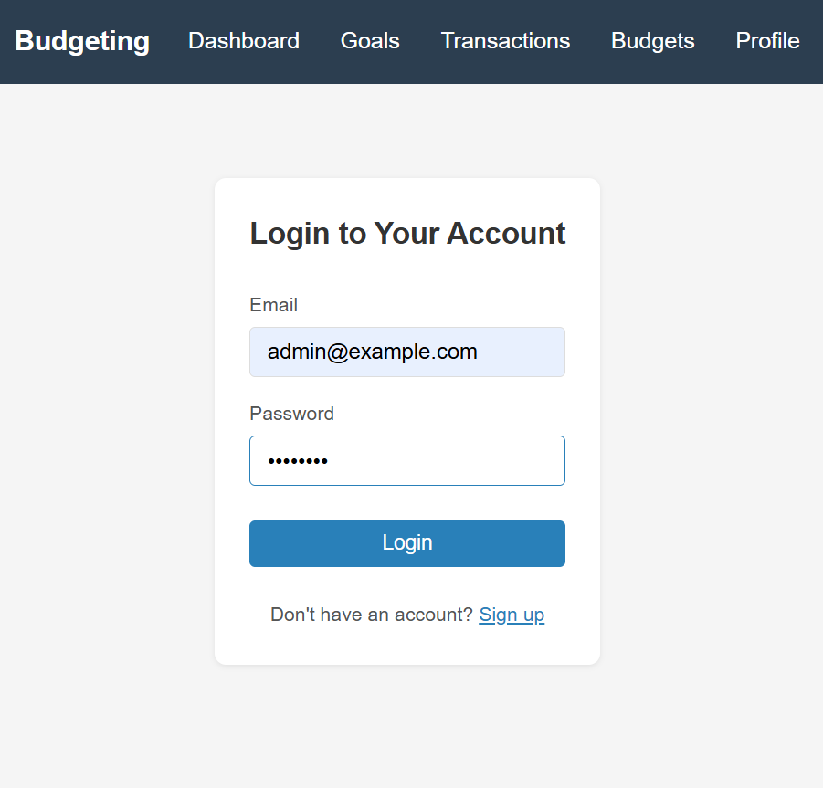
User Component
Sign up
Log in

Slide 11
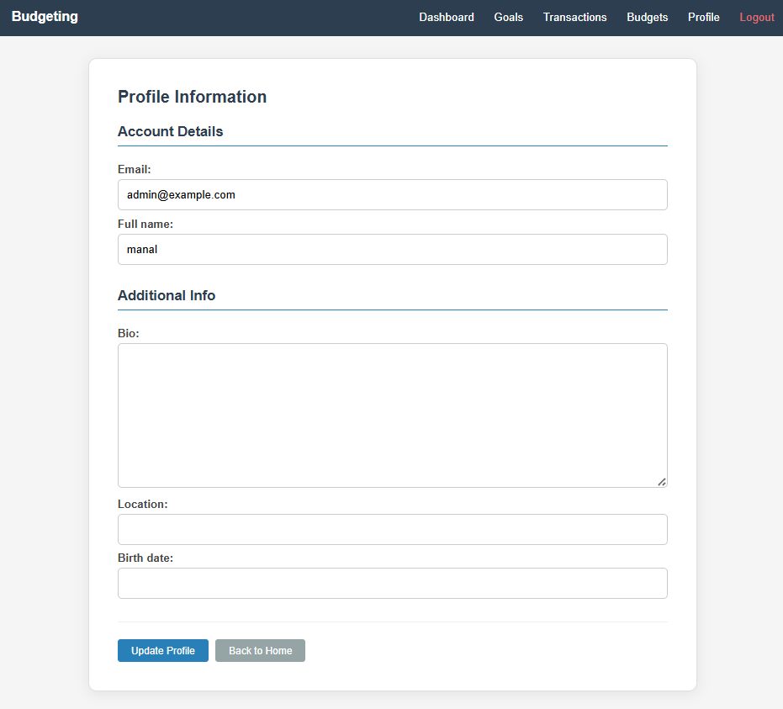
profile Component

Slide 12
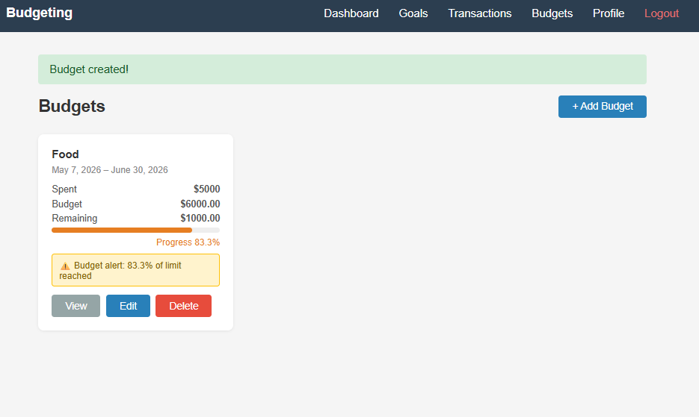
Budgets Component & Notification

Slide 13
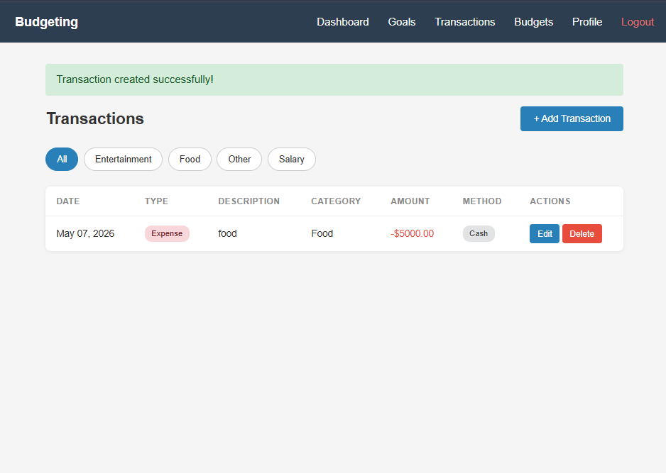
Transactions Component

Slide 14
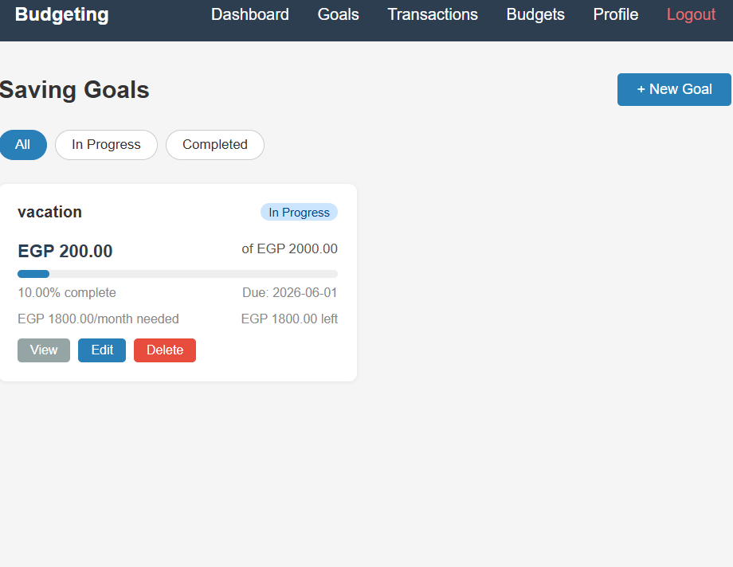
Savings Goals Component

Slide 15
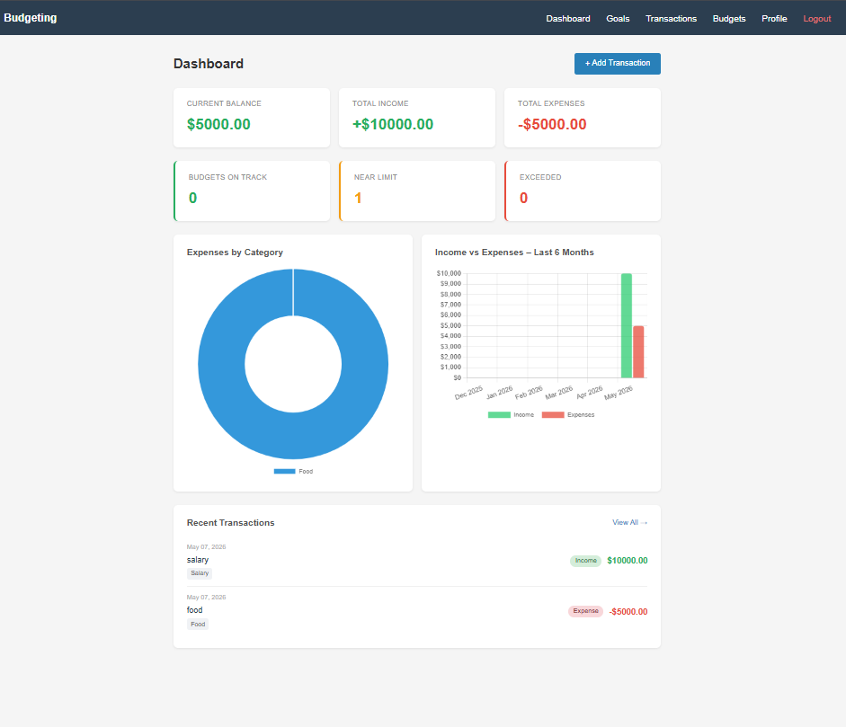
Dashboard

Slide 16
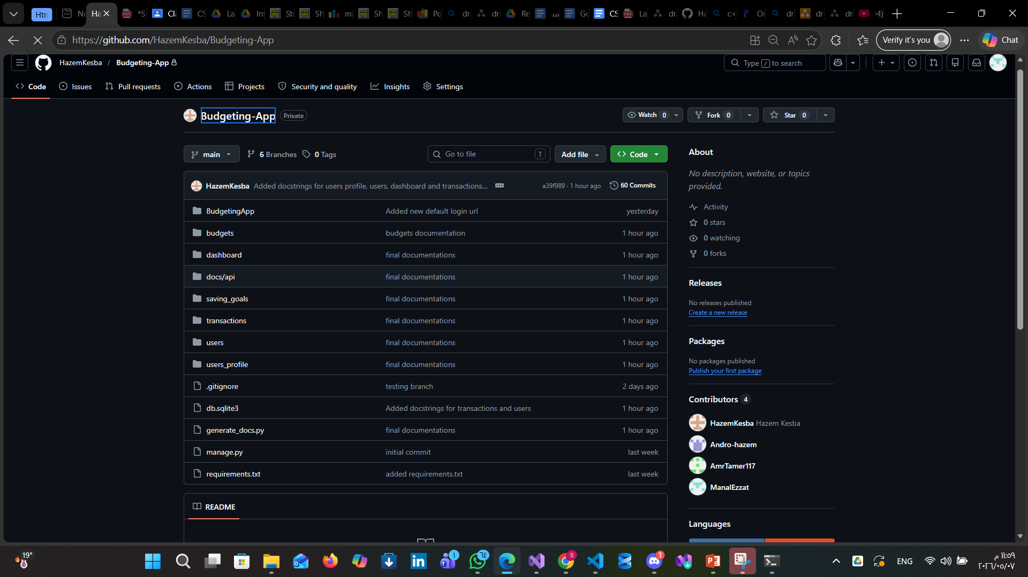
REPOSETORY https://github.com/HazemKesba/Budgeting-App

Slide 17
THANKS

